Slide 1


Student Funding
Student Induction
Notes:
Hi my name is Donna-Marie French and I am a Student Funding Manager here at Belfast Met, in today’s session I am going to run through various funding opportunities that may be available to whilst studying your course.

Slide 2

What we are going to Cover
Who we are
What we do
Why we are here
Overview of the various funds
How to find us
Notes:
Today I am going to cover who we are, what we do, why we are here, give you a brief overview of the various funds that may be available in support of your studies and where you can find us.

Slide 3
Who we are
Student Funding Team;
Donna-Marie French (Student Funding Manager)
Gerard Martin (Student Funding Officer)
Jane Holmes (Student Funding Officer)
Sam McElhinney(Student Funding Administrator)
Notes:
The Student Funding Team are as follows; the Student Funding Manager Donna-Marie , Student Funding Officers Gerard Martin & Jane Holmes and a student funding administrator Sam McElhinney

Slide 4
We help with Funding;
What we do?
Provide one-to-one advice
Help with applications for funding(Further & Higher Education)
Administer College internal funds such as Learner Support Fund, Care to Learn, Higher Education Bursary, Family Action & Belfast Met Laptop Scheme
Notes:
We are here to provide you with information, advice and guidance on various funding opportunities available in support of your studies. We aim to inform you about the range of financial assistance available, the relevant criteria and how you can access these funds. We are here to help you with applications for funding either Further and Higher Education and we administer College internal funds such as the Learner Support Fund, Care to Learn, Higher Education Bursary, Family Action & the Belfast Met Laptop Scheme

Slide 5
Funds we can advise on
Funds we can advise on
Full Time Higher Education Loans & Grants
Part Time Higher Education Loans & Grants
Full Time Further Education Grant
Part Time Further Education Grant
Educational Maintenance Allowance
Travel Pass
Prince’s Trust Development Award
Free School Meals
Notes:
There are a number of funds we can help with and they are listed above . Don’t worry about all of these, as only some will be open to you depending on your level of study and other factors . The important point is that there are funds available, you may be able to apply for some of these and we can provide advice as and when you need it .
The next few slides will take you briefly through the fund we administer in the College and you can contact us directly if you need more information.

Slide 6

Funds we administer
Learner Support Fund
Learner Support Fund Childcare
Care to Learn Scheme
Higher Education Bursary
Family Action Fund
Belfast Met Laptop Scheme
Notes:
The funds listed above are administered by our team and may be available to you. In this session I am going to give you a brief overview of funds that may be available to you in accordance with age and level of study, however please be aware that other factors(for example criteria) are important and must be considered. You may meet criteria in regards to age and level of study however all criteria must be met for you to be eligible for these funds.

Slide 7
Level 1-3 Further Education Full Time
(18 years of age or Under)
Age 16-17 on the 01st July 2023;
  Free School Meals
  Travel Pass & EMA
  Care to Learn Scheme
  Age 18 on the 01st July 2023;
  Travel pass
  EMA
  Learner Support Fund(If no EMA & Travel Pass)
  Care to Learn
Further Education
Notes:
I am now going to give you a brief overview of funds that may be available to you in accordance with age and level of study, however please be aware that other factors(for example criteria) are important and must be considered. You may meet criteria in regards to age and level of study however all criteria must be met for you to be eligible for these funds.
If you are studying a Level 1- 3 Full Time Further Education course and you are 16-17 years of age on 01st July you may be eligible to apply for Free School Meals(household income must be £16,190 or less) , a Travel Pass(you must live 3 miles or more away from the College and there must be no closer college that provides the same course) & EMA.
If you are 18 years old on the 01st July you may be eligible to apply for a Travel Pass & EMA. If you do not qualify for EMA please contact us to find out information and criteria for the Learner Support Fund.
This is a brief overview of EMA, this is a means tested allowance of £30 per week, paid fortnightly.
The household income of you or your parent(s)/guardian(s) must be £20,500 or less for households with one dependent child or; £22,500 or less for households with more than one dependent child. You can receive EMA for a maximum of three years, as long as the household income does not rise above the thresholds or you reach the age of 20.

Slide 8
Level 1-3 Further Education
Full Time(19 or over)
Age 19 on 01st July 2023;
EMA(If under 20 at start of course)
FE Grant(N/A to A-Level)
Learner Support Fund
Care to Learn(If under 20 at start of course)
Age 20+ on 01st July 2023
FE Grant(N/A to A-Level)
FE Grant Childcare(N/A to A Level)
Learner Support Fund
Further Education
Notes:
If you are Aged 19 or under and have a dependent child or children you could apply for help with childcare costs up to £165 per week through the Care to Learn Scheme whilst studying your course, this is providing you are using a registered Childcare Provider.
If you are aged 19 years or over on the 01st July, you may be eligible to apply for the Further Education Grant of up to £2092, household income must be under £38,805 and other factors and criteria must be considered.
If you are aged 20 years or over on 01st July and you are requiring help towards Childcare Costs whilst studying your course you may be eligible to apply for Childcare Assistance through the Further Education Grant.

Slide 9
Level 1-3 Further Education
Part Time
Age 16-18 on the 01st July 2023;
Learner Support Fund(must be 18)
Care to Learn
Age 19+ on the 01st July 2023
Part Time FE Grant(N/A to A-Level or <8hrs)
Part Time FE Grant Childcare(If 20 or over)
Learner Support Fund
Care to Learn(If under 20)
Further Education
Notes:
If you are studying a Level 1- 3 Part Time Further Education Course and you are 18 years old you may be eligible to apply for financial assistance through the Learner Support Fund, for help towards Fee Costs, Travel if you live 3 miles or more away from the College and Books and Equipment that are essential for your course.
If you are 19 or over on the 1st July 2023 and are studying a Level 1-3 Further Education Part Course you may be eligible to apply for the Further Education Grant for help of up to £465 towards Fee Costs and a Books and Equipment Grant(of up to £265), household income must be under £25,000 and other factors and criteria must be considered.
If you are 19 years of age or under and have a dependent child/children you could apply for the Care to Learn Scheme for help with Childcare whilst studying your course, providing you are using a registered Childcare Provider.
If you are 20 years of age or over on 01st July 2022 and you are requiring help towards Childcare Costs whilst studying your course you may be eligible to apply for Childcare Assistance through the Further Education Grant.

Slide 10
Where to find Criteria & Apply
Funding Source | Web address
EMA | www.nidirect.gov.uk
Travel Pass | www.eani.org.uk
Further Education Grant | www.eani.org.uk/feapplication
Care to Learn | studentfunding@belfastmet.ac.uk
Learner Support Fund | studentfunding@belfastmet.ac.uk
Learner Support Fund Childcare | studentfunding@belfastmet.ac.uk
Overview of funds and criteria | www.belfastmet.ac.uk/life-at-the-met/students-support/student-finance/
Notes:
This table provides you with the various funding sources I had mentioned for Further Education and the relevant web addresses for each of the funds to enable you to apply and to find out full eligibility criteria.

Slide 11
Level 4 – 6 Higher Education
Full Time
Student Finance NI(Online or PN1 Application)
Tuition Fee Loan
Maintenance Loan
Maintenance Grant
Childcare Grant(if you have dependent children)
DSA, PLA & ADG
Additional Funds:
Social Work Bursary(Social Work only)
Higher Education Bursary
Learner Support Fund
Higher Education
Notes:
If you are studying a Level 4 - 6 Higher Education Course Full Time, you could be eligible to apply for assistance through Student Finance NI(you can either apply online or paper based PN1 application) and be assessed for a Tuition Fee Loan(This is a non-means tested loan available to you to cover your Course Fees),
Maintenance Loan(A means tested loan available to assist with your living/accommodation costs. A higher rate loan is available if living away from family home)
and a Maintenance Grant( this is a means tested grant of up to £3,465 available to assist you with living/accommodation costs and doesn’t need to be repaid on the completion of your course) for the Maintenance Grant your household income must be under £41,065.
Additional Support through SFNI could be the Childcare Grant you have child dependents and are requiring help towards Childcare Costs, Disabled Students Allowance, Parents Learning Allowance & the Adult Dependent Grant, for more information and criteria please go to studentfinanceni.co.uk.
If you are studying BSc Degree in Social Work you could be eligible to apply for the Social Work Bursary(for more information please contact your Course Co-Ordinator).
The Higher Education Bursary may be also be available to you and the Learner Support Fund. Towards the end of the session I will be giving a brief overview of these two funds.

Slide 12
Level 4 – 6 Higher Education Part Time
Level 4 – 6 Higher Education
Part Time
Student Finance NI(Online or PTL Application)
Student Finance NI Part Time
Higher Education Tuition Fee Grant/Loan
Books & Equipment Grant
Other Funds
Care to Learn(If under 20)
Learner Support Fund Childcare
Learner Support Fund
Higher Education
Notes:
If you are studying a Level 4 - 6 Higher Education Course Part Time, and you are studying at least 50% of an equivalent full-time course, then you can apply for financial help. Your entitlement will depend on your household income and that of your spouse / partner. you could be eligible to apply for assistance through Student Finance NI(either online or a PTL application form) and assessed for Help with Course Fees and a Books and Equipment Grant,
You can apply for a Tuition Fee Grant, this is means tested grant available to you to help cover the cost of your course.
If the grant does not cover you entire fee or you are not eligible for the grant, there a non means tested Tuition Fee loan is available to you to help cover the cost of your course and
A Course Grant is also available this is a means tested grant of up to £265 to assist with the purchase of books etc.
If you are requiring help towards Childcare Costs whilst studying your Part Time Higher Education Course and are 19 years of age you could apply for the Care to Learn Scheme and if you are 20 years of age or over you can apply for help towards Childcare Costs through Learner Support Fund Childcare for help with Childcare whilst studying your course, please be aware that you must be using a registered Childcare Provider to avail of either one of these Childcare funding options.
If you are eligible for support with Fees and Books and Equipment through Student Finance NI, you could be potentially apply for support through the Learner Support Fund for help with travel costs this is providing you live 3 miles or more away from the Campus you are studying.

Slide 13
Where to find Criteria & Apply!!!
Funding Source | Web Address
Higher Education Full Time(online application or PN1 form) | www.studentfinanceni.co.uk
Higher Education(Full Time) Bursary | studentfunding@belfastmet.ac.uk
Higher Education Part Time(online application or PTL form) | www.studentfunding @belfastmet.ac.uk
Care to Learn | studentfunding@belfastmet.ac.uk
Learner Support Fund | studentfunding@belfastmet.ac.uk
Overview of funds and criteria | www.belfastmet.ac.uk/life-at-the-met/students-support/student-finance/
Notes:
This table provides you with the various funding sources I had mentioned for Higher Education and the relevant web addresses for each of the funds to enable you to apply and to find out full eligibility criteria.

Slide 14

Other Funds
Learner Support Fund
Learner Support Fund Childcare
Care to Learn
Higher Education Bursary
Family Action Fund
Notes:
Other Funds that may be available you are the Learner Support Fund, Learner Support Fund Childcare, the Care to Learn Scheme, the Family Action Fund and the In the next view slides, I am going to give you a brief overview of each of these Funds.

Slide 15
Learner Support Fund
Financial difficulty meeting costs associated with learning.
Means test (<£33,950) and the other eligibility criteria.
May be assessed under the following categories:
Course Fees
Living Costs (Full time only)
Book and equipment costs
Travel costs
Childcare
*All other funding sources must be availed of before applying.
Notes:
The Learner Support Fund may be available to you if you are experiencing financial difficulty meeting costs associated with your learning.
Students that apply to the Learner Support Fund and meet the means test which is under £33,950 and other eligibility criteria, you may be assessed under the following categories: Course Fees, Living Costs this is for Full Time Students only, Book and equipment costs, Travel costs and Childcare.
All other funding sources must be availed of and exhausted before applying.

Slide 16
Care to Learn Scheme
Available to young parents aged 16 to 19 years of age.
Childcare cost assistance up to £165 per week per child
Transport costs to and from their home & to their child care provider to the College.
Non means tested Award and the applicant cannot receive support towards childcare from any other source.
For more information regarding the scheme please get in touch with us via: studentfunding@belfastmet.ac.uk
Notes:
The Care to Learn Scheme is available to young parents aged 16 to 19 years of age. The award consists of assistance with childcare costs up to £165 per week per child and potentially transport costs to and from the College. The scheme is a non means tested Award and the applicant cannot receive support towards childcare from any other source.
For more information regarding the scheme please get in touch with us via the student funding inbox

Slide 17
Family Action Fund
Asylum Seekers attending the College.
Further Education Students.
Maximum grant of £300 and can assist with travel costs, books & equipment and Exam fees.
For information and criteria please contact the student funding service studentfunding@belfastmet.ac.uk
Notes:
The Family Action fund is a fund that the College has affiliated with, as no funding is currently available for Asylum Seekers attending the College, who are studying a Further Education course. The fund is a maximum grant of £300 and can assist with travel costs, books & equipment and fees. If this applies to you then please contact us on the application process. If an Award is granted the money is then transferred to the College who organise payment to the student.
For more information regarding the Family Action Fund, please get in touch with us via the student funding inbox

Slide 18
Higher Education Bursary
Higher Education Full Time Students
Low Income families
Attend & Progress on their Full Time Higher Education Course
Pay Variable Fees
Financially assessed by Student Finance NI
The Award is approximately 10% of the fee charged for the course e.g. A course that costs £2,905 = An award of £291
Award Released in Term 3
Notes:
The Higher Education Bursary is an Award paid to students from low income families who attend and progress on their Full Time Higher Education Course who pay variable fees.
The Award is approximately 10% of the overall fee charged for the course, for example a course that costs £2905 would equal an award of £291.
The process of the Higher Education Bursary is completed in Partnership with the Student Loan Company and therefore imperative that students apply through Student Finance NI to be assessed for the bursary.
For more info please go to the Student Funding section of the College website
www.belfastmet.ac.uk/life-at-the-met/students-support/student-finance/

Slide 19
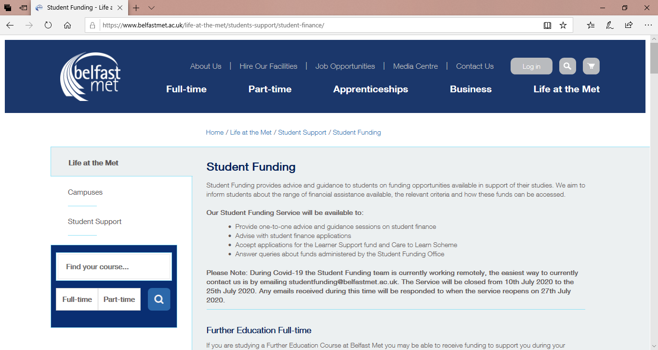
Student Funding(College Website)
Website
Please Note: Criteria applies for all funding options, for information on criteria please check out the Student Funding Section of the Website!!!!

Slide 20
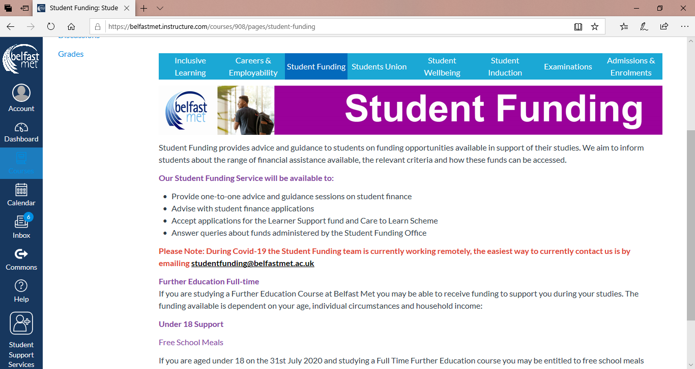
Student Funding(Canvas)
Canvas
Please Note: Criteria applies for all funding options, for information on criteria please check out the Student Funding Section of the Canvas Page!!!
Notes:
These are screenshots of the Student Funding Section of the College Website and Canvas Page where you can find information and criteria regarding each of the various funding opportunities I have mentioned in this information session. These will provide you with a links to the direct funding Source, where information and Full Criteria regarding each of the funds can be found.
Please Note: That Criteria applies for all funding options, for information on criteria please get in touch with us.

Slide 21

How & Where to find us??
Contact Details
Studentfunding@belfastmet.ac.uk or 028 90265183
Notes:
Should you have any queries at all, please email or phone student funding office to arrange an appointment.

Slide 22
Thank you for Listening
and
Good Luck with your studies
Notes:
We look forward to hearing from you, thank you for listening and if you have any queries regarding the funds I have mentioned, please get in touch and good luck with your studies.

