Slide 1



English as a Foreign Language
www.belfastmet.ac.uk/esol

Slide 2

Contents
Welcome. . . . . . . . . . . . . . . . . . . . 03
Our Facilities. . . . . . . . . . . . . . . . . . 04
Support Services. . . . . . . . . . . . . . 05
International Tuition Fees . . . . . . . 06
Courses . . . . . . . . . . . . . . . . . . . . . 07
Case Studies . . . . . . . . . . . . . . . . 08-09
Contact us . . . . . . . . . . . . . . . . . . 10
Notes:
The process of developing our Strategic Plan is an extremely important one.
It sets out our direction of travel for the next three years and will ultimately form the basis of business plans for departments and teams right across the College.

Slide 3

Welcome
“We take great pride in providing first class training and education and we are confident that Belfast Met will be the right choice for you. Many teaching staff within the centre are experienced and have in-depth knowledge of a wide variety of teaching methods. We are proud of our relaxed and supportive learning environment where you will be made to feel comfortable learning a new language or improving the language skills which you have already acquired.
Belfast Met is committed to excellence in every way. We pride ourselves on providing a complete student experience - in addition to a varied curriculum offering, we nurture your personal development and have a wide range of support services to assist you upon your educational journey.
All of our tutors have a passion for languages and foreign cultures and will create opportunities to share this with you, should you decide to join us.”
Louise Warde Hunter
Principal and Chief Executive
“Belfast Metropolitan College is the largest college in Northern Ireland. We have a long history of providing English language courses in Belfast and are proud to have been accredited by the British Council for the teaching of English since 2010.
We provide a variety of part-time English Language courses leading to international qualifications such as PET, FCE, CAE and CPE. We also provide IELTS Academic Preparation courses. Class sizes are set at a maximum of 20, although actual class sizes are often lower. Our campuses are well-equipped with interactive whiteboards and audio equipment to provide you with the best possible learning experience.
Our enthusiastic, dedicated teachers have experience of teaching both locally and internationally, and many of our teachers have postgraduate level qualifications in teaching English.”
Tere McBurney
Curriculum Area Manager
ext
Notes:
It’s important to start with the fundamentals and that means having total clarity about why our College exists and what it is we are here to do.
So, what is our purpose? Screen shows Purpose slide.

Slide 4

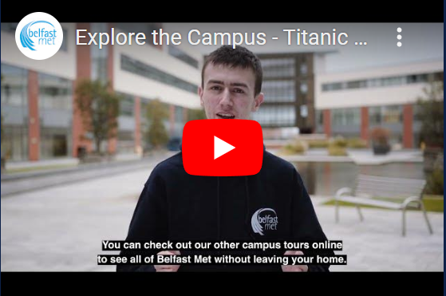
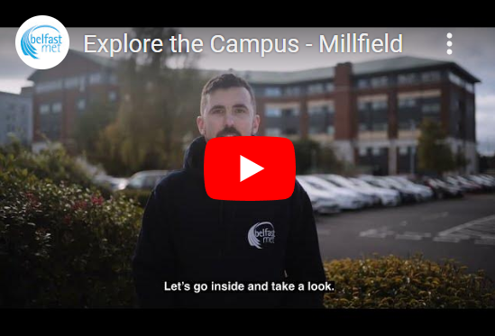
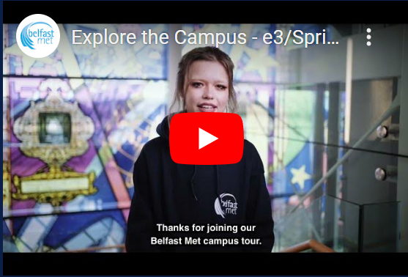
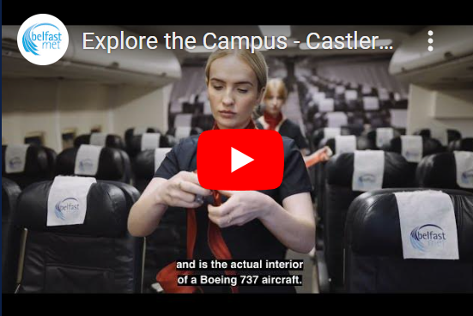
Our Campuses
Titanic Quarter
Millfield
E3
Castlereagh
Notes:
Louise, the directors and indeed everyone on the SLT is keen to involve as many staff as possible in the process of developing the strategy.
This is something that we all have to take ownership of.
(For information, we invited 175 managers to the engagement presentation and ELT hosted workshops on 15 April. This included Agency, Agreement for Services, NIPs staff etc. )
Managers aren’t in any way excluded from this particular series of engagement events but we are concentrating now on hearing the voices of staff at other levels, regardless of where you work or what contract you might be on.

Slide 5

Support Services
Career and Employability
Student Funding
Counselling Services
Inclusive Learning Click on the links to find out more
Student Wellbeing
Students’ Union
Safeguarding
Criminal Disclosure
Notes:
If that’s our purpose, then what do we want to achieve; what do we want to be as an organisation, what’s our Vision?

Slide 6

Part Time International Student Fees for EFL Courses only
Course | Weeks | Hours | Dates | Fee
Cambridge English PET B1 | 30 | 6 | Sept – June | £1759
Cambridge English First B2 | 30 | 6 | Sept – June | £1809
Cambridge English Advanced C1 | 30 | 6 | Sept – June | £1819
Cambridge English CPE C2 | 30 | 6 | Sept – June | £1829
IELTS course (1st semester) | 14 | 2.5 | Sept – Dec | £380
IELTS course (2nd semester) | 16 | 2.5 | Jan – May | £400
Hourly Rate | N/A | N/A | N/A | £9.05 Per Hour
Text
Learner
Notes:
Those three elements form three of our FIVE OBJECTIVES that will inform our strategic direction over the next three years.
Each element connects to and underpins the others.
We have our aspirations to be a College of Choice, an Employer of Choice and a Partner of Choice, all wrapped around the learner.
These three objectives are supported by a further two.
A commitment to be Digital by Design and Sustainable by Nature.
You’ll have hear Louise in her video referring to this a looking a little like an Olympics logo.

Slide 7

Cambridge English Courses
Cambridge English Entry Level Certificate in ESOL International (Preliminary)
Cambridge English Level 1 Certificate in ESOL International (First)
Cambridge English Level 2 Certificate in ESOL International (Advanced)
Cambridge English Level 3 Certificate in ESOL International (Proficiency)
IELTS preparation courses (Level 1 & 2)
Click on the links above to find out more.
Notes:
As we go through the next part of the presentation, have these questions in mind.

Slide 8

Case Studies
Essaid Mechiche (France)
“I’ve studied English for about two years at Belfas Met. I’ve done a few courses such as ESOL Level 2, IELTS and now CAE. At Belfast Met, there is a good opportunity to study English because there is help from the teachers, library staff and facilities and the IT equipment. I enjoy speaking in English, learning Idioms and the rich vocabulary. The more I learn here, the more fascinated I become with the language.”
​
Talal Abdullah (Sudan)
“I’ve been studying English at Belfast Met since January 2014. I started in the First Certificate course and now I am in the CAE class. What I really like about studying here is that the teachers are really helpful and they are really concerned about everyone’s progress. The resources and library that are available to students is comprehensive.”
Maria Moya (Spain)
“I’ve been studying at Belfast Met since Jan 2013. I started at Intermediate and I am currently doing the Advanced course. I consider this to be a great and challenging experience for me. On the one hand, studying at Belfast Met is helping me to improve my English and on the other hand, it is a huge challenge. I’ve had a good time and it’s been an experience for me.”
Indre Tunile (Lithuania)
“I attended ESOL classes at various levels, including City and Guilds and IELTS preparation courses. I found all of the classes very beneficial in progressing my language skills and knowledge. The courses were well structured, easy to follow and conducted at the right pace. Also, all of the teachers I came across were very helpful, tactful and with a sense of humour, which I particularly liked.”
Notes:
You will have seen Jonathan Heggarty covering this in his video, and you will heard him outline why this Objective is so important.
For a start, it speaks to the very reason why we are here in the first place.
We are here to provide high quality and valued education and skills to a diverse range of learners. And we are to do this whilst meeting our dual role of delivering the skills needed for economic growth and addressing social and economic inclusion.
To be a College of Choice, we must ensure that the programmes we deliver meet the needs of learners, employers and society in general, now and into the future.
We have to be agile in the types of courses we offer – responding to what is needed - and flexible in how we deliver them. And, of course, we also need to make sure we can compete with other providers – e.g. schools and universities.
The Actions are all self-explanatory and of course we are doing many of these already. But is there anything missing? What do we need to get better at doing?

Slide 9
Mustora Adams (South Africa)
“I completed the CAE now known as the C1 Advance course. I now reap the benefits of the course as it taught me to converse more eloquently and increased my vocabulary tremendously. I very much enjoy studying at Belfast Met and like that I had fellow students that were on the same path, with similar goals and determinations. With all the available resources, campus’ library and user -friendly study material, it made studying less over whelming. As an auditory leaner I appreciated the classroom discussions, continuous tests and evaluation conducted by my lecturer that kept me on par with the curriculum. I gained valuable insight and skills during this course that should be beneficial for any future endeavors and will definitely consider a career in teaching English.”
Nataliia Chepurna (Ukraine)
“I started my FCE course in Sep 2022. My first teacher recommended transferring to CAE as it would benefit me more. I accepted the challenge and am happy to participate in such a thrilling course. Studying at BMC improves not only my level of English but also gives me confidence in everyday communication and work. During the lessons, we discuss different topics and complete various tasks, which allows us to express our thoughts and find new friends. I am proud to be a part of Belfast Met family and the Northern Irish community.
Khaled Zalitou (Syria)
“I'd never learned English in my life before I came to Belfast, I'm 56 now. From my experience BMC is one of the best educational institutions I've been through in my life. I will not talk about the modern building and high-tech equipment used in education, or the wonderful library, etc. Rather, I will talk about the most important element in any educational institution, which is the wonderful administrative staff and the Student Union who work to secure everything necessary for the students. What impressed me in Belfast Met is the team of extraordinary teachers who are academic professionals and human beings. In the college, I passed five important stages in the English language, from ESOL entry one and I am now about to take the FCE exam. Every year I am amazed by the most wonderful teachers. All this makes me bow before this cultural and educational edifice.”
”

Slide 10

Any questions?
Contact us
Phone - 028 9026 5496
Email - ESOL@belfastmet.ac.uk

Slide 11

Thank You

